Slide 1


Formulas
John Horn

Slide 2
Simultaneous games
Payoff matrix
Solution framework for simultaneous games
Each player’s strategies listed either in rows or columns
Equilibria listed as pairs of strategies, not payoffs
Dominant strategy
Always better regardless of what the other side chooses
Players opt to play their dominant strategy if they have one
Dominated strategy
One that is never optimal, regardless of the opponent’s action
Can be eliminated from the payoff matrix

Slide 3
Simultaneous games
Nash Equilibrium
Find each player’s best response to other players’ potential strategies
Nash Equilibrium are any cells in payoff matrix where all players are playing best responses
May be zero, one, or multiple Nash Equilibria

Slide 4
Sequential games
Game tree
Solution framework for sequential games
Players make choices at nodes, branches represent potential strategic choices
Backward induction
Determine best responses at terminal nodes (final moves)
Transfer relevant payoffs to previous nodes
Determine best responses at second-to-last nodes, write payoffs at previous nodes, repeat
Follow path of selected branches from top-to-bottom to indicate equilibrium (pairs of strategies, not payoffs)

Slide 5
Sequential games
Dominant strategy
No such thing in sequential games!
Credible threats
Visible (others must know you’ve made a threat)
Understandable (others must know impact of threat to them)
Irreversible (you can’t be bluffing and change your plans)

Slide 6
Principal-agent concepts
Principal-agent relationship
Principal hires/contracts with the agent to act on the principal’s behalf
Agent’s actions affect principal’s outcomes
Principal-agent problem
Principal and agent may have misaligned objectives
E.g., principal wants profit maximization; agent wants a bigger role, political appointment, etc.
Principal and agent may have different risk preferences
E.g., board wants aggressive growth; CEO is nearing retirement and doesn’t want to jeopardize reputation or separation package
Principal and agent may have different effort preferences
E.g., board wants focus on company; CEO may have attention on philanthropic or other ventures

Slide 7
Profit maximization – monopoly
MR = MC
Marginal revenue = marginal cost
dR/dQ = dC/dQ
Monopoly markup
(P – MC)/P = -1/ε_{D}
Profit margin = inverse of own-price (demand) elasticity
MES
Minimum efficient scale
Lowest point on Long Run Average Cost (LRAC) curve
Point where LRMC and LRAC intersect

Slide 8
Profit maximization – competitive firms
How much to produce?
Marginal revenue = marginal cost [MR = MC]
MR = P for competitive firm, so reduces to P = MC
Should we produce?
If P ≥ AC where MR = MC
Short-run: P ≥ AVC + AAFC (average avoidable fixed costs)
Long-run: P ≥ ATC
Entry/exit
If Profits_{Long run} > 0, then firms will enter
If Profits_{Long run} < 0, then firms will exit
If Profits_{Long run} = 0, no entry or exit

Slide 9
Profit maximization – competitive firms
Short-run equilibrium
Market demand = Market supply
Firms maximize profit (MR = MC, or P = MC)
Long-run equilibrium
Market demand = Market supply
Firms maximize profit (MR = MC, or P = MC)
Firms collect zero economic profit (P = ATC)

Slide 10
Oligopolies fall between perfect competition and monopolies
Perfect competition
Oligopoly
Monopoly
Description
Multiple competitors, none with ability to affect market price
Firms select optimal production point
P = MC
E.g., restaurants, hair salons
Several competitors, each with some pricing power
Firms focus on either price or quantity when setting strategy
Profit maximization depends on strategic interaction
E.g., soft drinks
One company selling in market
Set price & quantity if unregulated
MR = MC
E.g., power distribution

Slide 11
Oligopoly
X-firm concentration ratio
Sum of market shares of X largest firms
4 firm ratio:
> 60% Tight oligopoly
[60%, 40%] Loose oligopoly
< 40% Effectively competitive
1 firm ratio: > 90% Effectively monopoly
Herfindahl-Hirschman Index (HHI)
Sum the squares of the ALL market shares
DoJ guidelines
Unconcentrated (competitive) HHI < 1,000
Moderately concentrated [1,000 ; 1,800]
Highly concentrated HHI > 1,800

Slide 12
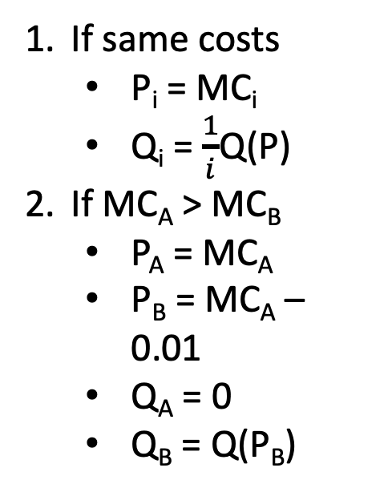
Overview of oligopoly models
Bertrand
Cournot
Stackelberg
Choice variable
Price
Quantity
Quantity
Timing
Simultaneous
Simultaneous
Sequential
Solution
If same costs
P_{i} = MC_{i}
Q_{i} = $\frac{1}{i}$Q(P)
If MC_{A} > MC_{B}
P_{A} = MC_{A}
P_{B} = MC_{A} – 0.01
Q_{A} = 0
Q_{B} = Q(P_{B})
MR_{i} = MC_{i}
Solve for Q_{i} to get BRF_{i}
Plug BRF_{B} into BRF_{A}
Solve for Q_{A}
Plug Q_{A} into BRF_{B}
Solve for Q_{B}
Q = Q_{A} + Q_{B}
P = P(Q)
If A moves first
Plug BRF_{B} into Inv. Demand_{A}
Calculate MR_{A}
MR_{A} = MC_{A}
Solve for Q_{A}
Plug Q_{A} into BRF_{B}
Solve for Q_{B}
Q = Q_{A} + Q_{B}
P = P(Q)
Notes: Subscript i is shorthand for applying the same formula for A, B, C …
BRF is abbreviation for “best response function”

Slide 13
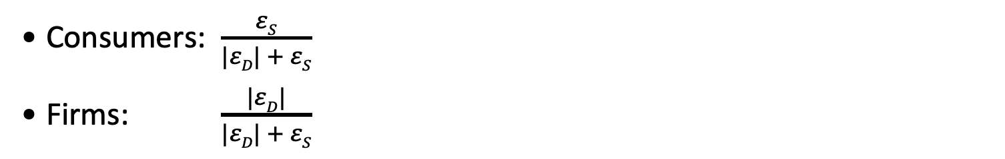
Taxes and subsidies
Per-unit
tax (t)
P_{F} is price collected by the firm
P_{C} is price paid by consumers
Tax on customers: P_{C} = P_{F} + t [P_{F} is price tag]
Tax on firms: P_{F} = P_{C} – t [P_{C} is price tag]
Who bears burden?
Consumers: $\frac{εS}{|εD| + εS}$
Firms: $\frac{|εD|}{|εD| + εS}$
Per-unit
subsidy (s)
Subsidy to customers: P_{C} = P_{F} – s [P_{F} is price tag]
Subsidy to firms: P_{F} = P_{C} + s [P_{C} is price tag]
In both cases, s = -t, so subsidies are negative taxes

Slide 14
Introduction to Microeconomics
Producer surplus
Area below the market price and above the supply curve
½ * equilibrium quantity * (market price – supply choke price)
Deadweight loss
Triangle area below demand curve and above supply curve, between market quantity and competitive equilibrium quantity
½ * (comp. equil. quantity – market quantity) * (P_{D}(Q_{M}) – P_{S}(Q_{M}))

Slide 15
Other government regulations
Price ceiling
Maximum price above which price cannot go
Must be below competitive equilibrium price
Customers receive extra consumer surplus
Price floor
Minimum price below which price cannot go
Must be above competitive equilibrium price
Suppliers receive extra producer surplus
Quantity restriction
Maximum quantity above which quantity cannot go
Must be less than competitive equilibrium quantity
Firms receive extra producer surplus

